Slide 1
Interview Trainer Agent
AICTC IBM PROJECT
Presented By:
Student name : Navinkumar Tirupati Tumma
College Name & Department : G H Rasioni College Of Engineering & Management

Slide 2
OUTLINE
Problem Statement
Technology used
Wow factor
End users
Result
Conclusion
Git-hub Link
Future scope
IBM Certifications

Slide 3
Problem Statement :22
Problem Statement
Interview preparation is often fragmented and generic, failing to address the specific needs of candidates based on their job role, experience, and industry. Manual research across platforms for relevant questions, behavioral scenarios, and company expectations is time-consuming and inefficient.
💡 Proposed Solution
An AI-powered Interview Trainer Agent that uses Retrieval-Augmented Generation (RAG) and IBM Granite models to:
Generate personalized interview questions and strategies
Retrieve role-specific content from trusted sources (recruitment portals, company databases, etc.)
Provide model answers and improvement tips
Support both technical and soft skill evaluation
Users simply input their resume or job title, and the agent delivers a comprehensive, targeted interview prep experience.

Slide 4
Technology used
IBM Cloud Lite Services
IBM Watsonx AI Studio & Runtime
IBM Granite Foundation Model
Retrieval-Augmented Generation (RAG)
Natural Language Processing (NLP)

Slide 5
Wow factors
Hyper-Personalized Interview Prep Tailors question sets and strategies based on the user's resume, job title, experience level, and target industry—no more generic advice.
Real-Time Retrieval of Industry-Specific Content Uses RAG to pull the latest interview questions, role expectations, and HR guidelines from recruitment portals, company databases, and professional networks.
Behavioral Scenario Simulation with Feedback Presents realistic behavioral questions and evaluates user responses using NLP-based sentiment and structure analysis—ideal for HR and managerial roles.
Dual Skill Assessment: Technical + Soft Skills Covers coding questions, system design, domain-specific queries, as well as communication, leadership, and problem-solving scenarios.
Simulated Q&A Sessions for Confidence Building Interactive mock interviews with voice/text support, helping users refine tone, pacing, and clarity—like having a virtual coach.
Adaptive Learning Loop Tracks user progress and dynamically adjusts question difficulty and feedback based on performance trends.
Role-Specific Strategy Recommendations Offers preparation strategies tailored to roles like Software Engineer, Data Analyst, Product Manager, etc., including company-specific tips.

Slide 6
End users
Job Seekers (Freshers & Experienced): Get tailored interview prep to boost confidence and improve success rates in competitive hiring.
Career Coaches: Use the agent to provide personalized guidance and mock interview sessions for their clients.
HR Training Teams: Enhance internal candidate readiness with role-specific interview simulations and feedback tools.
Placement Cells in Colleges: Support students with smart, scalable interview preparation aligned to industry expectations.

Slide 7
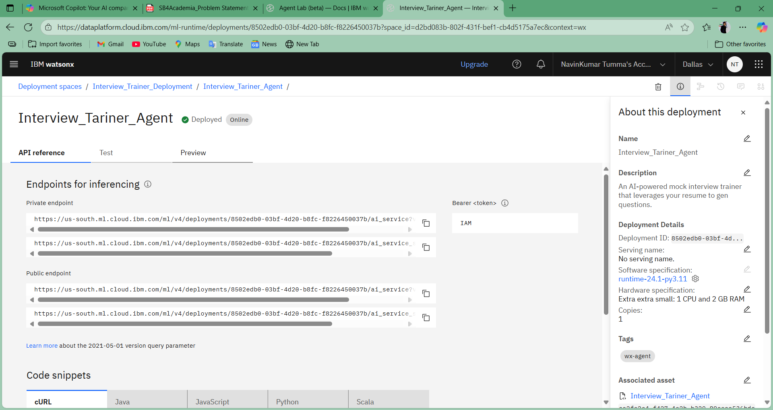
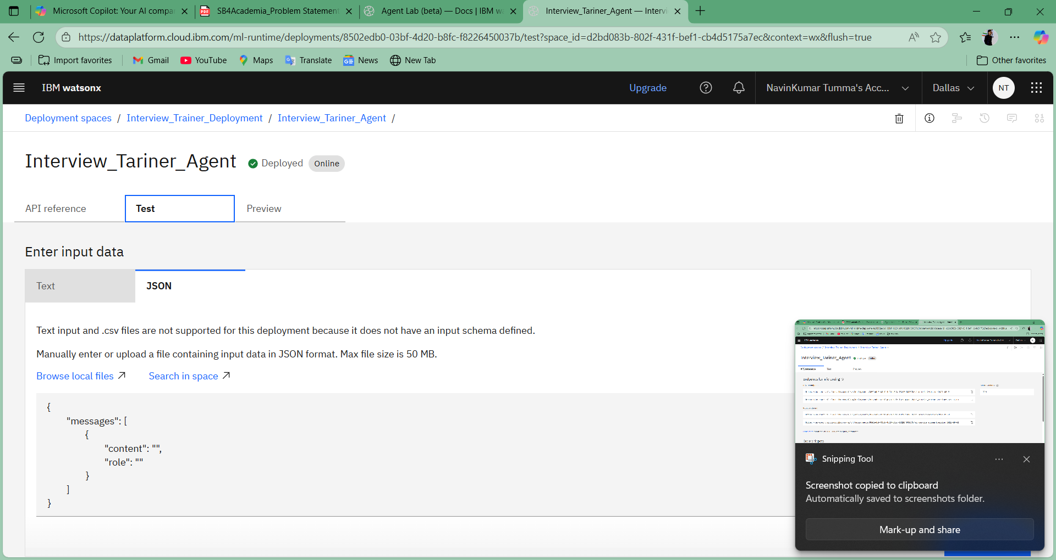
Results

Slide 8
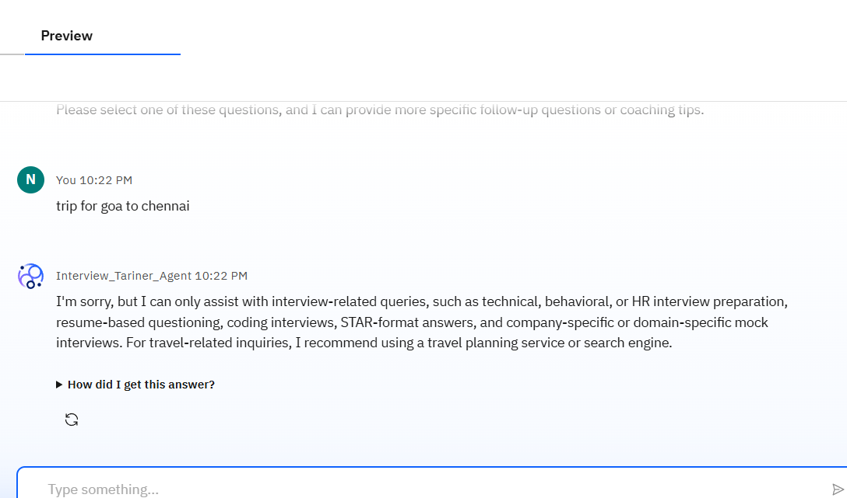
Results

Slide 9
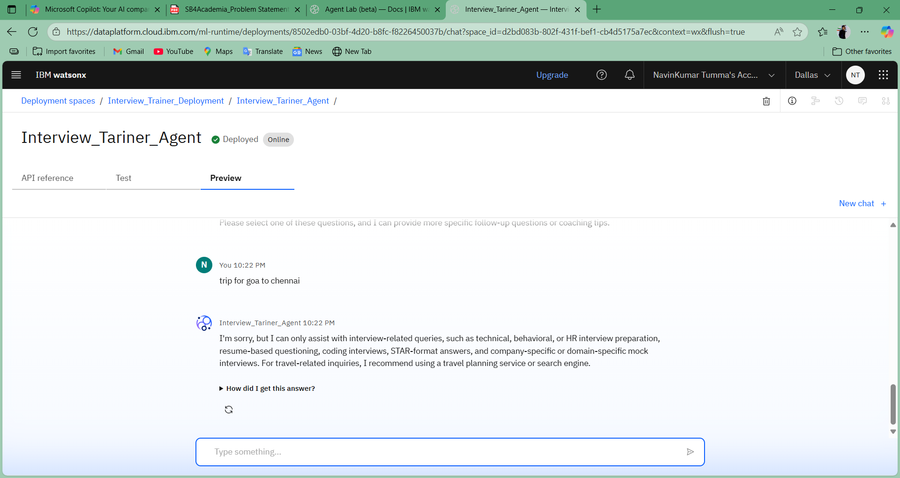
Results
Deployed AI Agent

Slide 10
Conclusion
The Interview Trainer Agent transforms interview preparation from a generic checklist into a smart, adaptive coaching experience. It empowers users to respond with clarity, confidence, and relevance, making them stand out in competitive hiring scenarios.

Slide 11
GitHub Link
Make sure that there should be readme file

Slide 12
Future scope
Voice-based mock interviews
Multilingual support
Integration with job portals (e.g., LinkedIn, Naukri)
Real-time feedback scoring
Resume enhancement suggestions

Slide 13
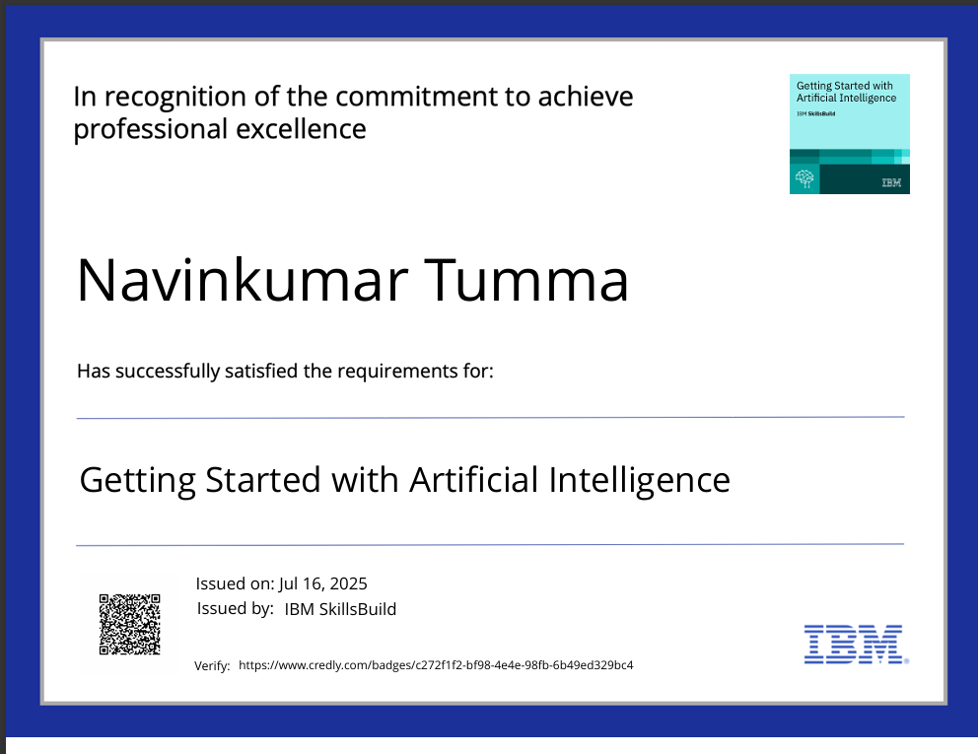
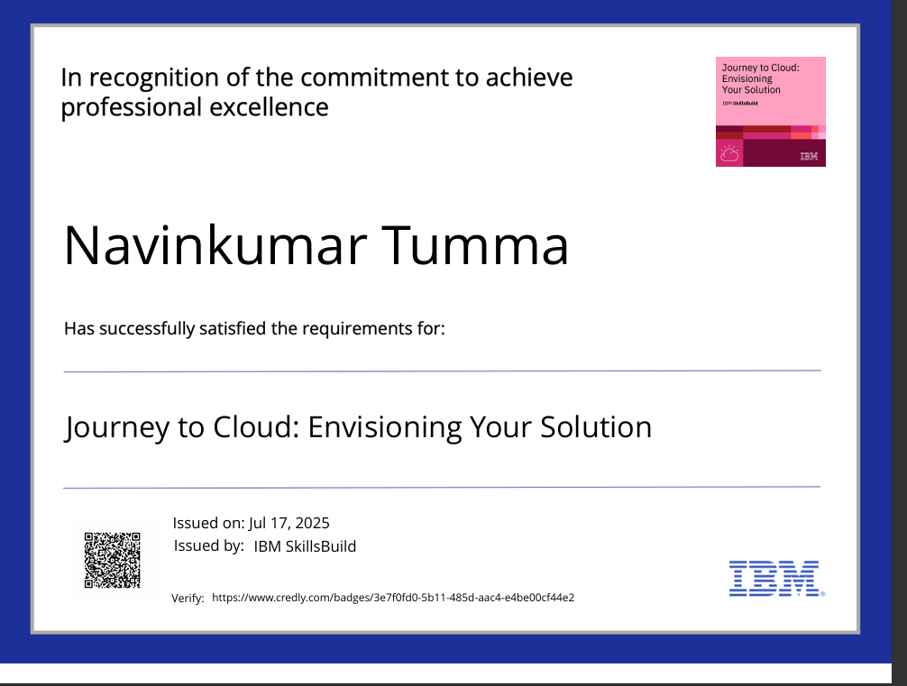
IBM Certifications

Slide 14
THANK YOU

